Slide 1
SUPPORT TICKET SYSTEM

Slide 2

PROBLEM STATEMENT
A Support Ticket System helps users report and track technical issues in one place.It enables support agents and administrators to manage, assign, and resolve tickets efficiently.

Slide 3

METHODOLOGY
User logs into the system and creates a support ticket.
The ticket is assigned to a support agent for review and resolution.
The agent updates the ticket status and provides solutions.
The user can track the progress of the ticket.
The administrator monitors and manages all tickets.

Slide 4
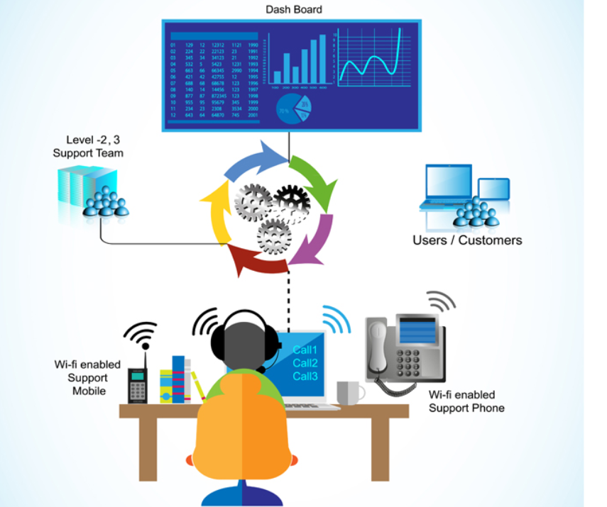
OUTCOMES
Easy creation and tracking of support tickets.
Faster communication between users and support agents.
Improved issue management and quicker problem resolution.
Better organization and monitoring of support requests.

Slide 5

CONCLUSION
The Support Ticket System provides an easy way to report, manage, and resolve support issues.
It improves communication between users and support staff while reducing response time.

